Slide 1
Characterization of the Boundary of the Set of Matrix-Exponential Distributions with only Real Poles
Qi-Ming He, Mark Fackrell, and Peter Taylor
University of Waterloo, University of Melbourne
MAM 10, Tasmania, Australia
Feb. 15, 2019

Slide 2
Outline
Introduction
Problem of Interest
Examples and Intuition: Ω₁, Ω₂, Ω₃, and Ω₄
The General Case Ω_{m}
Discussion

Slide 3
1. Introduction
A nonnegative random variable X has an ME-distribution if its probability distribution function has the form:
  where α is a 1×m row vector, T is an m×m matrix, and v is an m×1 column vector. The 3-tuple {α, T, v} is called an ME-representation of the ME random variable X. The elements of {α, T, v} can be real or complex numbers, as long as F(t) is a probability distribution function. Without loss of generality, we assume α₀ = 0.
ME-distributions were introduced in Asmussen and Bladt (1996).

Slide 4
1. Introduction (continued)
The LST of X is given by
Given φ(s), an ME-representation can be obtained as {α, T, v}, where α = (a₁, a₂, …, a_{m}) = a, v = (0, 0, …, 0, 1)′ = e_{m}, and
  The pole(s) of φ(s) or the zero(s) of b(s) of the maximum real part is real and negative.

Slide 5
1. Introduction (continued)
Definition Given b(s), define Ω_{m} the set of all vectors a = (a₁, a₂, …, a_{m}) such that φ(s) = a(s)/b(s) defined in the above equation is the LST of a density function.
Proposition (Bean, Fackrell, and Taylor (2008)) The set Ω_{m} is
  nonempty;
  contained in the upper half-space a_{m} ≥ 0;
  closed;
  bounded; and
  convex.
They also characterized ∂Ω₃, the boundary of Ω₃, is completely.

Slide 6
2. Problem of Interest
Let {–λ₁, –λ₂, …, –λ_{m}} be distinct real numbers and the zeros of b(s) (or the poles of φ(s) = a(s)/b(s)).
Given the poles, we want a detailed characterization of ∂Ω_{m}, the boundary of Ω_{m}. That is: we want to find a = (a₁, a₂, …, a_{m}) in ∂Ω_{m}.
Comments:
  All a in the interior of Ω_{m} correspond to a phase-type distribution. The PH-order of those phase-type distributions goes from 1 to infinity.
  Some distributions in ∂Ω_{m} are not phase-type, since their density function is zero at some x > 0 (i.e., f(x) = 0).

Slide 7
2. Problem of Interest (continued)
Given λ₁ > λ₂ > … > λ_{m} > 0,
  Let F_{i}(t) and f_{i}(t) be the distribution and density functions of the exponential random variable X_{i} with parameter λ_{i}, respectively, for i = 1, 2, .., m.
  Define

Slide 8
2. Problem of Interest (continued)
Rewrite φ(s) as
with x₁+x₂+…+x_{m} = 1, which is equivalent to
We want to find all x = (x₁, x₂, …, x_{m}) such that f(t) is a density function, which is equivalent to identify Ω_{m} and ∂Ω_{m}. We shall use the same notation.

Slide 9
3. Examples and Intuition
m = 1: φ(s) = a(s)/(s+λ₁) = λ₁/(s+λ₁)
  X has to be exponential with parameter λ₁, with X₁ and f₁(t).
  Ω₁ has only one element.
m = 2: φ(s) = a(s)/(s+λ₁)(s+λ₂)
= pλ₁/(s+λ₁) + (1–p)λ₁λ₂/(s+λ₁)(s+λ₂)
  X has to be the convex sum of exponential X₁ and X₁+X₂ (i.e., a generalized Erlang distribution, f₁₂(t)): pf₁(t) + (1–p)f₁₂(t)).
  Ω₂ contains (only) a line segment with two ending points X₁ and X₁+X₂. (p < 0 or p > 1?) (Note: λ₁ > λ₂)
  That is: ∂Ω₂ = {f₁(.), f₁₂(.)}.

Slide 10
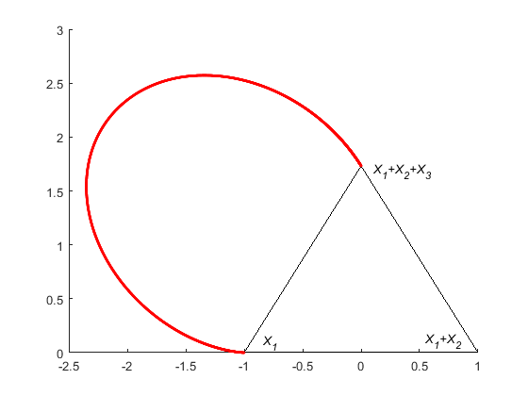
3. Examples and Intuition (continued)
m = 3: φ(s) = a(s)/(s+λ₁)(s+λ₂)(s+λ₃)
  X has to be the affine sum of X₁(i.e., f₁(t)), X₁+X₂ (i.e., f₁₂(t)), and X₁+X₂+X₃ (i.e., f₁₂₃(t)):
  p₁ f₁(t) + (1 – p₁ – p₂)f₁₂(t) + p₂ f₁₂₃(t)
  Ω₃ contains a triangle with three vertices X₁, X₁+X₂, and X₁+X₂+X₃.
  Ω₃ looks like an ice-cream cone (Dohen and Latouche (1982))

Slide 11
3. Examples and Intuition (continued)
m = 3: φ(s) = a(s)/(s+λ₁)(s+λ₂)(s+λ₃)
  The curved part connecting f₁(.) and f₁₂₃(.)
    f(t) = 0 and f’(t) = 0 for some t > 0 (to find corresponding p₁ and p₂)
    Thus, the curved part can be obtained by solving the above system for t = 0 to ∞. For t → 0, f(.) → f₁(.); For t → ∞, f(.) → f₁₂₃(.);
  In summary, ∂Ω₃ = conv{f₁(.), f₁₂(.)}∪ conv{f₁₂(.), f₁₂₃(.)}∪ ∂_{c}Ω₃. (Dohen and Latouche (1982))

Slide 12
3. Examples and Intuition (continued)
m = 4: φ(s) = a(s)/(s+λ₁)(s+λ₂)(s+λ₃)(s+λ₄)

Slide 13
3. Examples and Intuition (continued)
Four sides: Ω₃{f₁(.), f₁₂(.), f₁₂₃(.)}; Ω₃{f₁(.), f₁₂(.), f₁₂₃₄(.)};
Ω₃{f₁(.), f₁₂₃(.), f₁₂₃₄(.)}; Ω₃{f₁₂(.), f₁₂₃(.), f₁₂₃₄(.)};
ABC: One side; ABD: One side
BCD: Two sides; ACD: Two sides

Slide 14
3. Examples and Intuition (continued)
Thus, ∂Ω₄ consists of
  ice-cream cone Ω₃{f₁(.), f₁₂(.), f₁₂₃(.)} (including ABC)
  ice-cream cone Ω₃{f₁₂(.), f₁₂₃(.), f₁₂₃₄(.)} (including ABD) and
  a curved part (the green surface)

Slide 15
3. Examples and Intuition (continued)
Find the curved part of ∂Ω₄: For t > 0, we use f(t) = 0 and f’(t) = 0 to find the curved part of the boundary.
For each t > 0, we find one solution g_{1,t}(.) in ∂_{c}Ω₃{f₁(.), f₁₂(.), f₁₂₃(.)} and g_{2,t}(.) in ∂_{c}Ω₃{f₁₂(.), f₁₂₃(.), f₁₂₃₄(.)}.
The curved part of ∂Ω₄ is: ∪_{t>0} conh{g_{1,t}(.), g_{2,t}(.)}, where g_{1,t}(.) ∈∂_{c}Ω₃{f₁(.), f₁₂(.), f₁₂₃(.)} and g_{2,t}(.) ∈∂_{c}Ω₃{f₁₂(.), f₁₂₃(.), f₁₂₃₄(.)}

Slide 16
4. General Case Ω_{m}
m: φ(s) = a(s)/(s+λ₁)(s+λ₂)(s+λ₃)(s+λ₄)...(s+λ_{m})
  f(t) = x₁f₁(t) + …. + x_{m}f_{12…m}(t)
Assume that λ₁ > λ₂ > … > λ_{m}.
Ω_{m} is between affine spaces π₁ and π₂:
(for Ω_{m-1}) (for Ω_{m-1} with f₁₂(.), f₁₂₃(.), …, f_{12…m}(.))

Slide 17
4. General Case Ω_{m} (continued)
If m > 3, ∂Ω_{m} consists of three part:
  Ω_{m–1} (= π₁∩Ω_{m}),
  π₂∩Ω_{m}, and
  A curved part ∂_{c}Ω_{m}.
π₂∩Ω_{m}: Generated by f₁₂(.), f₁₂₃(.), …, f_{12…m}(.), which can be characterized similar to Ω_{m-1}.

Slide 18
4. General Case Ω_{m} (continued)
The curved part ∂_{c}Ω_{m}
  We define Ω_{k{3}} as
    Ω_{k{3}}= ice-cream cone {f_{1…k}(.), f_{1…k(k+1)}(.), f_{1…k(k+1)(k+2)}(.)}
    for k = 1, 2, …, m–2.
  For t > 0, we solve f(t) = f’(t) = 0 to find a solution g_{t,k}(.) in Ω_{k{3}} for k = 1, 2, …, m–2. The solution is apparently in the curved part of ∂Ω_{k{3}}, that is: g_{t,k}(.) ∈ ∂_{c}Ω_{k{3}}.
  Then all solutions in conv{g_{t,k}(.), k = 1, 2, …, m–2} satisfying f(t) = f’(t) = 0, which should be in the curved part of ∂Ω_{m}.
  Then the curved part can be expressed as
    U_{t>0}conv{g_{t,k}(.): g_{t,k}(.) ∈ ∂_{c}Ω_{k{3}}. k = 1, 2, …, m–2}.

Slide 19
4. General Case Ω_{m} (continued)
Then ∂Ω_{m} consists of
    Ω_{m–1,}
    π₂∩Ω_{m}, and
    U_{t>0}conv{g_{c,t,k}(.): g_{c,t,k}(.) ∈ ∂_{c}Ω_{k{3}}. k = 1, 2, …, m-2}.

Slide 20
5. Discussion
We still need to give rigorous mathematical proofs.
Details on π₂∩Ω_{m}.
Cases with complex poles (might be similar?)
What are the potential applications?
  To check whether or not a = (a₁, a₂, …, a_{m}) represents a probability distribution.

Slide 21
Thank you very much!
Any question?
Dehon, M.; Latouche, G. A geometric interpretation of the relations between the exponential and generalized Erlang distributions. Advances in Applied Probability. 1982, 14, 885-897.
Fackrell, M. Characterization of Matrix-exponential Distributions. PhD thesis, School of Applied Mathematics, University of Adelaide, South Australia, 2003.
Bean, N.; Fackrell, M.; Taylor, P. Characterization of matrix-exponential distributions. Stochastic Models, 2008, Vol 24 (3), 339-363.

Slide 22
3. Examples and Intuition (continued)
m = 3: φ(s) = a(s)/(s+λ₁)(s+λ₂)(s+λ₃)
  The curved portion of the ice-cream cone:
    For any f(.) on the curve, there exists (at least one) t > 0 such that f(t) = 0.
    The curve is generated by letting t to go from 0 to infinity. (An explicit formula is given in Dohen and Latouche (1982))

Slide 23
3. Examples and Intuition (continued)
m = 3: φ(s) = a(s)/(s+λ₁)(s+λ₂)(s+λ₃)
  Edges:
    p f₁(t) + (1 – p)f₁₂(t): Not expandable (i.e., 0 ≤ p ≤ 1)
    p f₁(t) + (1 – p) f₁₂₃(t): Not expandable (i.e., 0 ≤ p ≤ 1)
    (1 – p)f₁₂(t) + p f₁₂₃(t): Not expandable (i.e., 0 ≤ p ≤ 1)
  Sides:
    [f₁(t), f₁₂(t)]: The half plane contains f₁₂₃(t)
    [f₁₂(t), f₁₂₃(t)]: The half plane contains f₁(t)
    [f₁(t), f₁₂₃(t)]: Both sides contain ME-distributions
  The curved part connecting f₁(t) and f₁₂₃(t)

Slide 24
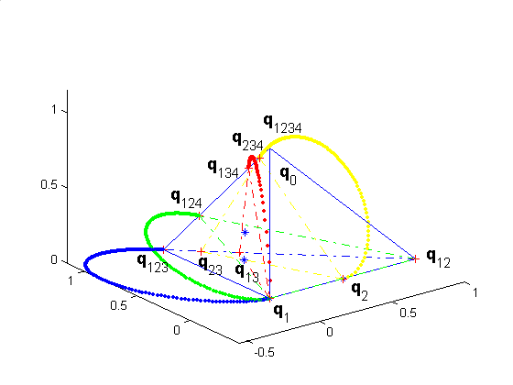

Slide 25
3. Examples and Intuition (continued)
So, to find a solution f(.) in the curved part of ∂Ω₄, the two equations f(t) = 0 and f’(t) = 0 for some t > 0 is not enough to find f(.) directly.
The idea is to find one solution in ∂_{c}Ω₃{f₁(.), f₁₂(.), f₁₂₃(.)} and one in ∂_{c}Ω₃{f₁₂(.), f₁₂₃(.), f₁₂₃₄(.)}. Then f(.) is in the convex hull of the two solutions. This is the basic idea for finding the curved part of ∂Ω_{m} of m > 4.

