Slide 1
Models for the evolution of gene-duplicates: Applications of Phase-Type distributions.
Tristan Stark¹, David Liberles¹, Małgorzata O’Reilly^{2,3} and Barbara Holland²
¹ Temple University, Philadelphia
² University of Tasmania, Australia
³ ARC Centre of Excellence for Mathematical and Statistical Frontiers (ACEMS)
13-15 February 2019
The Tenth International Conference on Matrix-Analytic Methods in Stochastic Models
This research was supported by the Australian Government through the Australian Research Council's Discovery Projects funding scheme (project DP180100352)

Slide 2
Talk Aims:
Set up the biological background required to understand the problem (for both this talk and Jiahao’s) so bear with me
Show how the problem can be approached using tools from the MAM toolkit
Encourage more interaction between the math biology and MAM communities

Slide 3
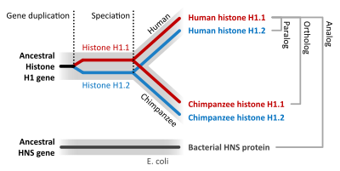
Biological background
Gene duplication is thought to be a major source of evolutionary novelty
For a gene to be maintained in a genome it needs to be protected by selection, but, by definition, when it arises a gene duplicate is redundant…
Various authors have proposed that this results in a “race” between different possible fates
One copy of the gene gets destroyed by mutation (pseudogenization)
Both copies get kept but with reduced and complementary functionality (subfunctionalization)
One gene acquires a new function that becomes protected (neofunctionalization)

Slide 4
Genes can have more than one function
Many genes have more than one function, e.g. they might be expressed in different tissue or at different developmental stages
Different subfunctions tend to be controlled by different regulatory elements within the genome

Slide 5
Theoretical model for evolution of a duplicate gene pair, based on paper by Force et al…
Duplication
Genes are modelled as having two components: regulatory regions (short boxes) each responsible for some function of the gene, and the coding region (long boxes) which codes for protein.
Full function
Lost function
New function
Loss of function
Loss of function
Nonfunctionalisation
Neofunctionalisation
Subfunctionalisation
Force, A., Lynch, M., Pickett, F. B., Amores, A., Yan, Y. L., & Postlethwait, J. (1999). Preservation of duplicate genes by complementary, degenerative mutations. Genetics, 151(4), 1531-1545.

Slide 6
Absorbing state Markov chains
Deuce
Adv.
Player 1
Adv.
Player 2
Game
Player 1
Game
Player 2

Slide 7
Subfunctionalization
Pseudofunctionalization
State transition diagram for a duplicate pair with z = 4 regulatory regions just considering pseudogenisation and subfunctionalisation.
Black regions are unaffected by mutation; white regions have had a null mutation meaning that function is lost; grey regions are protected from null mutations by selection.
The top row shows gene pairs that have subfunctionalised, i.e. both genes are protected by selection; the bottom row and far right show pseudogenisation, i.e. one copy of the gene has been lost.

Slide 8
Phase Type distributions
The problem is similar to a PH distribution with the distinction that we have two absorbing states: pseudogenization (P) and subfunctionalisation (S)
Q*
V
$z$ is the number of regulatory regions
States $0$ up to $z−1$ track the number of regulatory regions that have been lost
$μ_{c}$and $μ_{r}$ are the rates of loss of coding and regulatory regions respectively

Slide 9
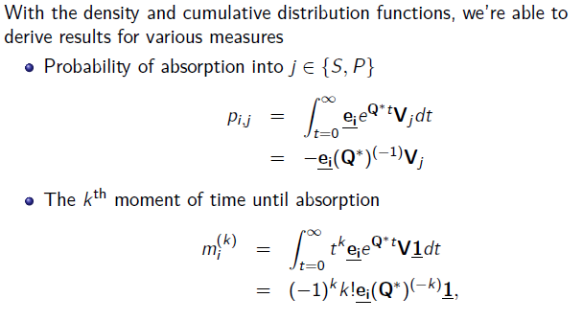
Phase Type distributions
The problem is similar to a PH distribution with the distinction that we have two absorbing states: pseudogenization (P) and subfunctionalisation (S)
Q*
V

Slide 10
Two kinds of hazard rates
Instantaneous rate of transition into state P given that the process is has not yet been absorbed into either state S or P.
Instantaneous rate of transition into state P given that the process has not yet been absorbed into state P (we call this the pseudogenization rate)

Slide 11
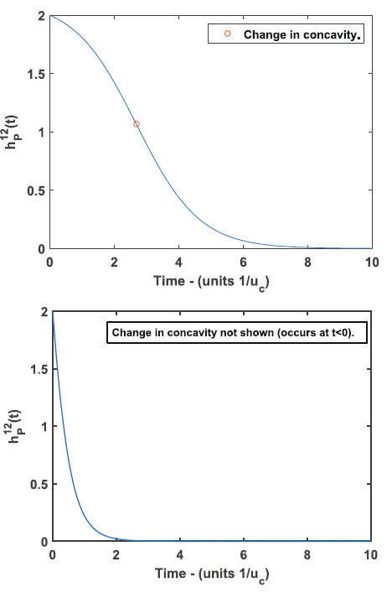
Different parameter choices give different hazard functions
Different choices of $μ_{c}$and $μ_{r}$ (the rates of loss causing mutations in the coding a regulatory regions) and z (the number of regulatory regions/functions) give different shaped curves.
When $μ_{r}$ / $μ_{c}$ < a critical threshold (that depends on z) the change in concavity occurs in positive time, otherwise the shape of the hazard function is indistinguishable from exponential decay

Slide 12
Fitting to data
The data we have consists of counts of the number of duplicate pairs in a genome with corresponding estimates of the cumulative number of silent substitutions per silent site (i.e. a proxy for age)
To draw a link between the hazard rate curves and the data we also need to make some assumptions about how duplicate genes arise.
Assume that gene duplicates arise according to a Poisson process with rate $β_{0}$
Assume that all gene duplicates evolve under the same set of parameters

Slide 13
Pulling it all together
Define a random variable Y(t) as the number of gene duplicates that have survived to time t
This allows us to fit our model to data using a Maximum Likelihood approach

Slide 14
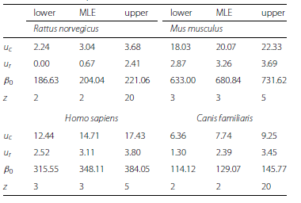
Results
Previous results had suggested that subfunctionalization was not a good explanation for observed data
Using our model we could show that subfunctionalization actually fits observed data pretty well.

Slide 15
Extensions
More than 2 genes
Ongoing duplication
Partial duplication
Neofunctionalization
Speciation
More generally, it seems like evolutionary biology should be rife with other examples of PH distributions
E.g. the covarion model of sequence evolutions
Current Birth/Death models for phylogenetic trees assume exponential waiting times (terrible fit to actual tree shapes)

