Slide 1


Why phylogenetics?
Barbara Holland
School of Physical Sciences
University of Tasmania

Slide 2
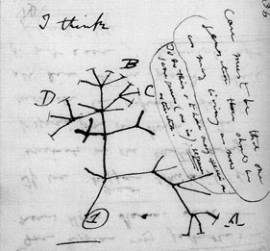
What is phylogenetics?
The primary goal of phylogenetics is to infer evolutionary relationships between species.
This includes both information about order of branching, .e.g., did humans and chimpanzees share a common ancestor more recently than humans, chimps and gorillas? And information about timing of events, e.g., how long ago did humans and chimps share an ancestor?
Darwin’s sketch: the first phylogenetic tree?

Slide 3
Tips on reading trees
1
3
2
3
3
2
2
4
1
4
4
1
1
2
3
4
1
2
4
3
3
4
1
2
3
4
2
1
1
2
3
4

Slide 4
Reason 1
Just because…

Slide 5
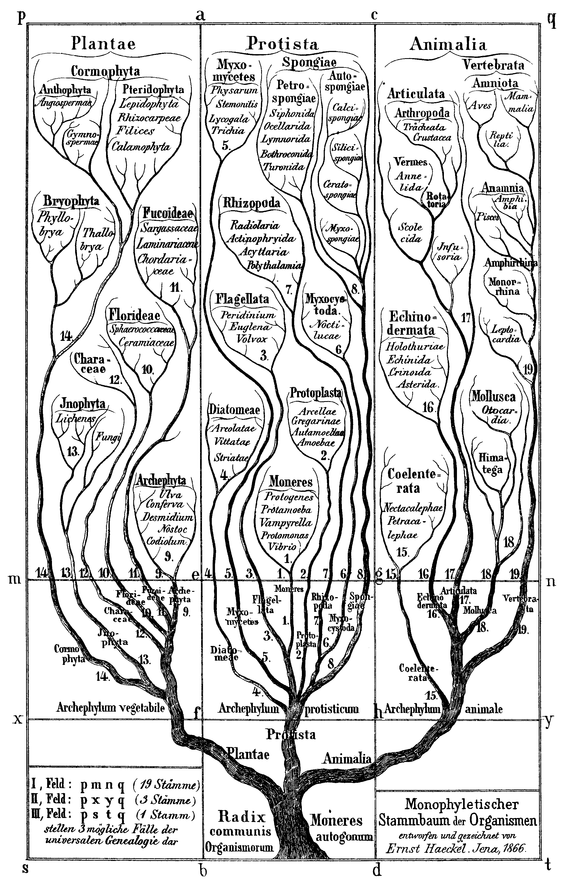
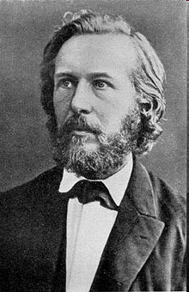
Ernst Haeckel’s Tree of Life (1866)
Since the publication of Origin of the Species in 1859 people have been trying to infer the evolutionary Tree of Life.

Slide 6
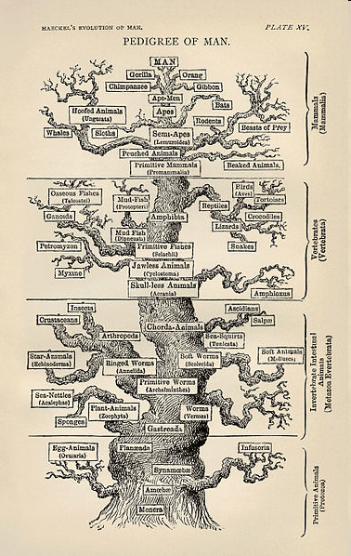
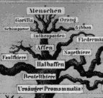
Haeckel’s Pedigree of Man

Slide 7
Why molecular phylogenetics?
It is difficult to compare the ankle bones of whales to those of other artiodactyls.
Most molecules evolve independently of adaptations affecting morphology.
It is fairly easy to find genes that are present in all species of interest, e.g., a 12S RNA molecule in mitochondria is functional over all mammals.
Useful mathematical models of sequence evolution have been developed that underpin attempts to infer evolutionary trees

Slide 9
Mathematics
State of the art
  Likelihood and Bayesian inference techniques based on continuous time Markov models
  Clever heuristics to make searching for the best tree practical
Open Questions
  How to pick the best model
  Dangers of over-fitting versus under-fitting
  How to tell if your model fits adequately
  How best to make really big trees
Statistics
Algorithm design
Graph theory

Slide 10
Reason 2
To understand origins

Slide 11
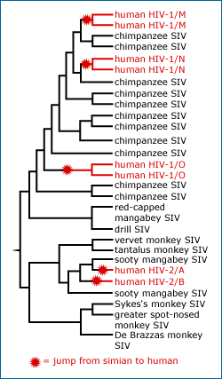
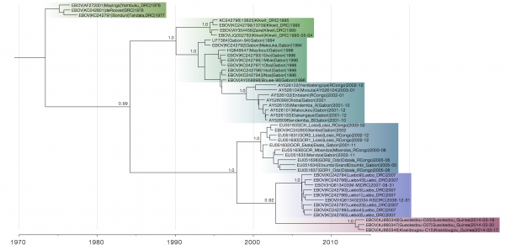
…indicates that the outbreak in Guinea is likely caused by a Zaire ebolavirus lineage that has spread from Central Africa into Guinea and West Africa in recent decades, and does not represent the emergence of a divergent and endemic virus.
Dudas G, Rambaut A. Phylogenetic Analysis of Guinea 2014 EBOV Ebolavirus Outbreak. PLOS Currents Outbreaks. 2014
http://evolution.berkeley.edu/evolibrary/news/081101_hivorigins

Slide 12
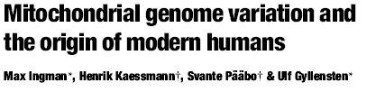
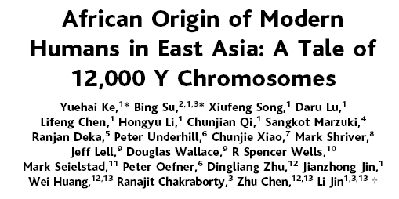
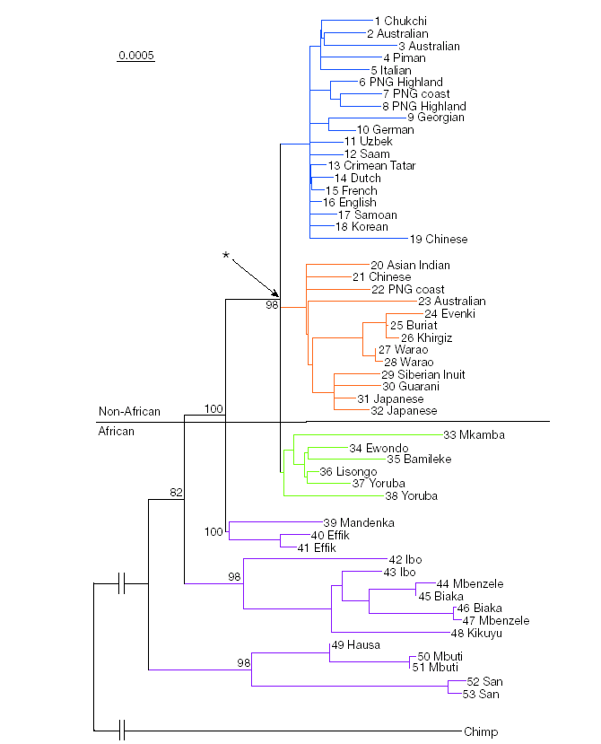
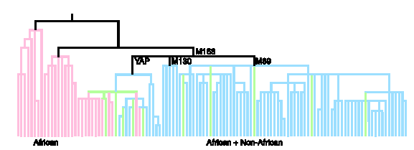

Slide 14
Mathematics
Issues
  For many questions of interest the exact details of the tree aren’t crucial, but we do want to know whether or not our conclusions are robust to uncertainty in our phylogenetic inference
State of the art
  Bayesian inference using Markov chain Monte Carlo (MCMC)
  allows us to treat the tree as a nuisance parameter
Open questions
  Bayesian methods are only feasible for moderately sized data sets
Statistics
Algorithm design

Slide 15
Reason 3
Timing is everything

Slide 17

Asteroid hits, dinosaurs die, birds and mammals inherit the Earth?
BAH. It’s a Marxist view that denies a role for competition!

Slide 18
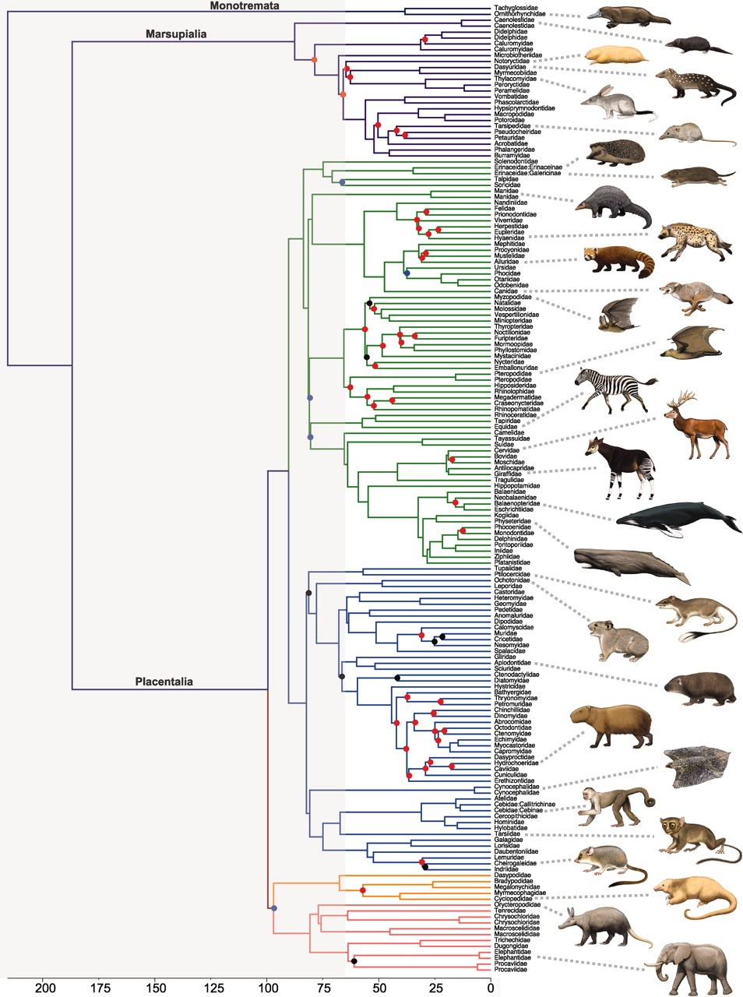
Meredith, R. W. et al. 2011. Impacts of the Cretaceious terrestrial revolution and KPg extinction on mammal diversification. Science 334:521-524

Slide 21
Mathematics
State of the art
  Bayesian inference using Markov chain Monte Carlo (MCMC) allows us to use fossils to put priors on the age of nodes in the tree
Open questions
  What sorts of things affect the ‘ticking’ of the molecular clock?
  How best to incorporate prior information, e.g. about fossils
  Why do rates appear to speed up towards the present?
Statistics
Algorithm design

Slide 22
Reason 4
To understand how traits evolve (and co-evolve)

Slide 23
Phylogeny as a confounding variable

Slide 24
Phylogeny as a confounding variable

Slide 25
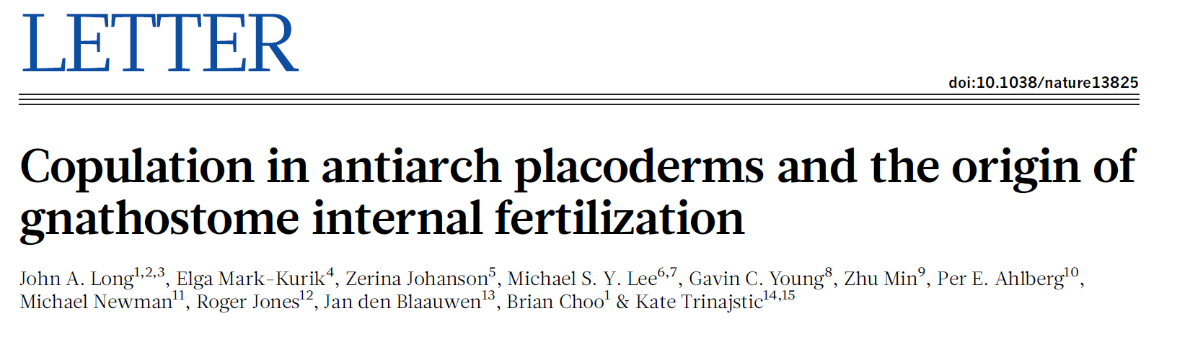
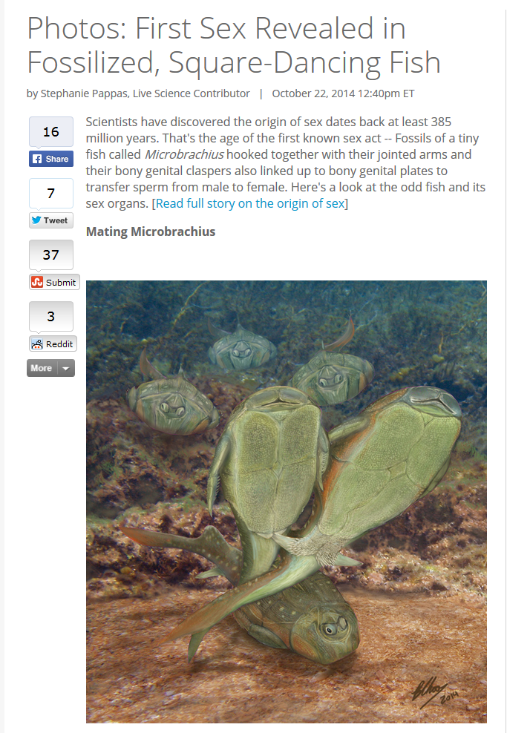
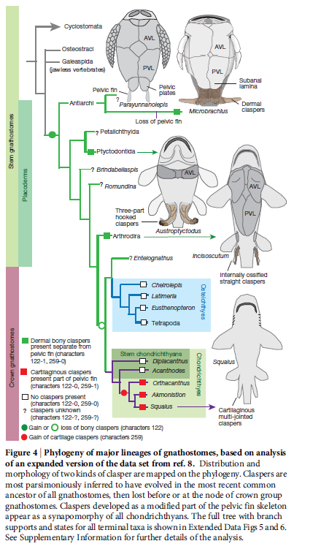

Slide 28
Mathematics
State of the art
  Up until very recently methods of ancestral state reconstruction assumed that the evolutionary process was neutral and homogeneous across the tree
Open questions
  What if the trait (or something else it is correlated with) influences the tree (i.e. affects rates of speciation or extinction?
  What if rates of trait evolution change across the tree? Could we detect it?
  What if hidden traits have an influence on what we see? Could we detect it?
Stochastic models
Branching processes

Slide 31
Reason 5
To understand macroevolutionary patterns

Slide 34
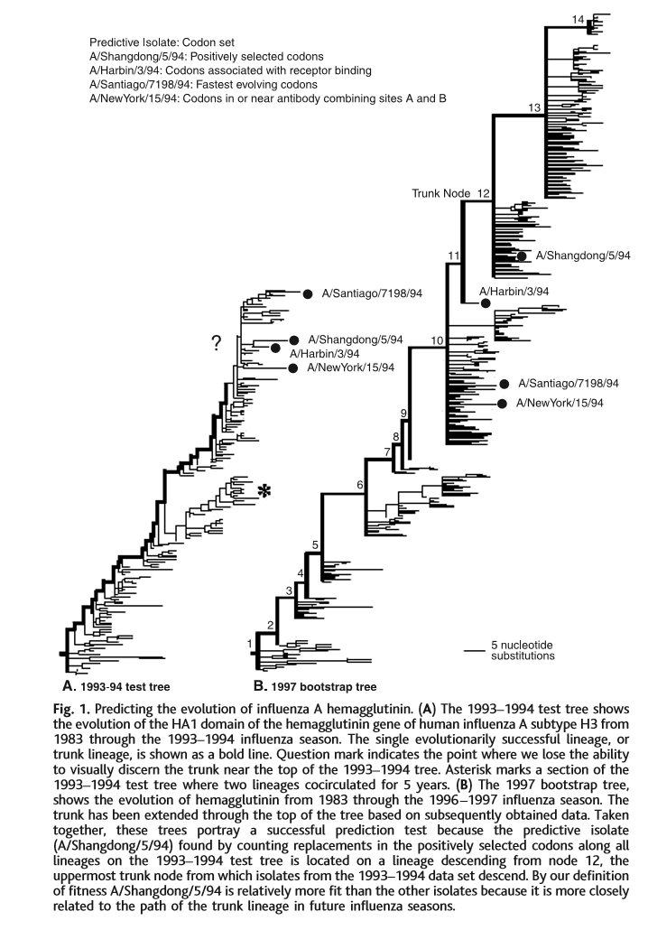
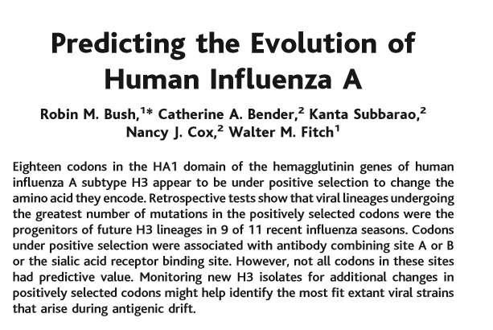

Slide 35
Mathematics
State of the art
  Up until recently, birth-death models. In the last few years more complex models have been introduced: BiSSE, models with shifts in diversification rate
Open questions
  How much information about process can be squeezed out of tree shape?
  What sorts of processes give rise to tree shapes that we observe?
Stochastic models
Branching processes

Slide 36
Reason 6
To annoy people in other fields

Slide 38
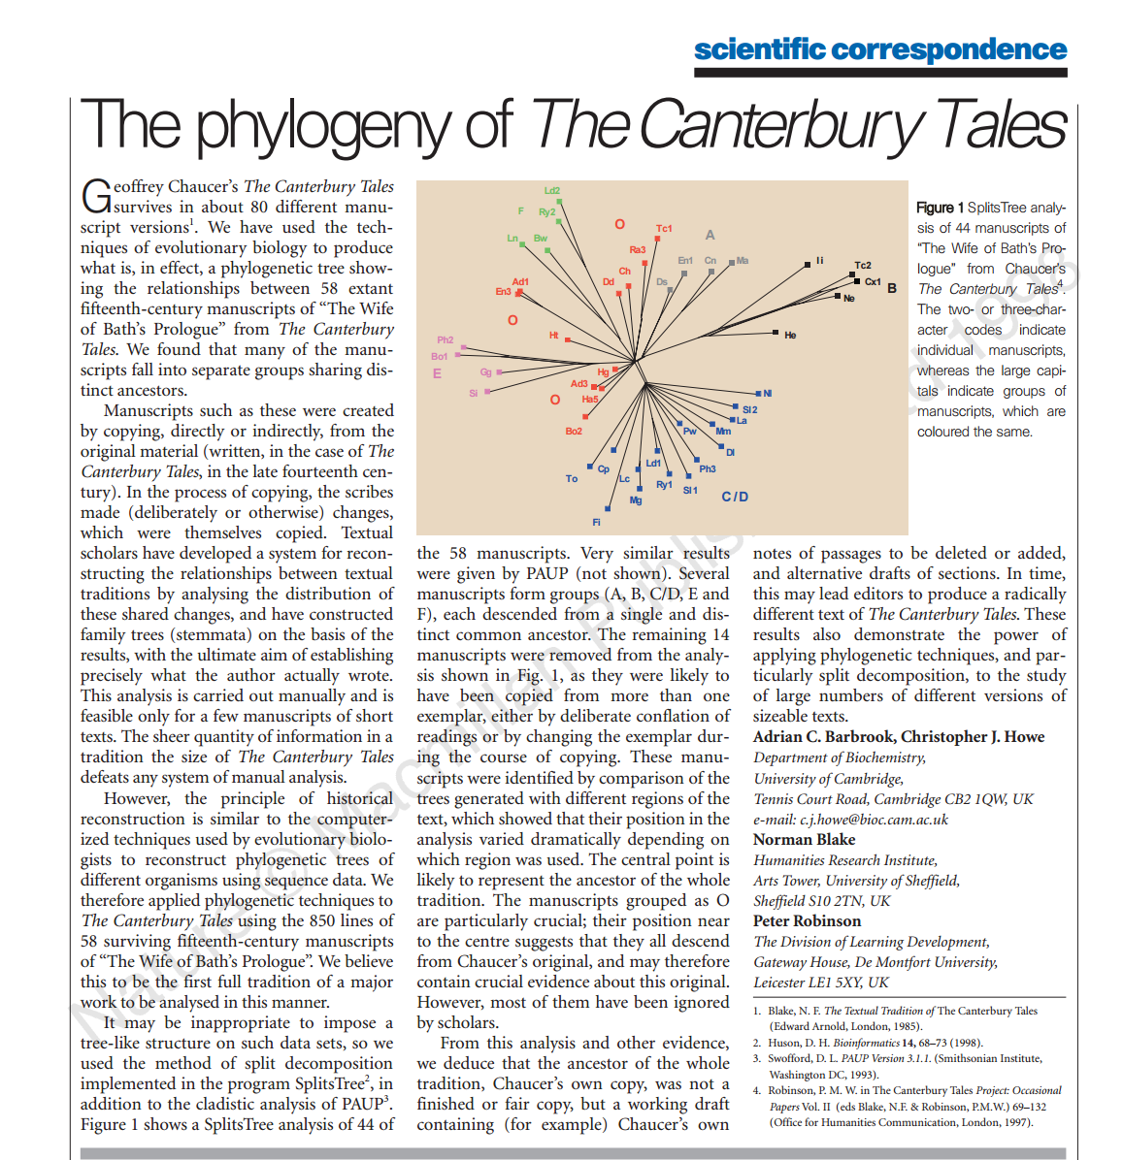

Slide 39
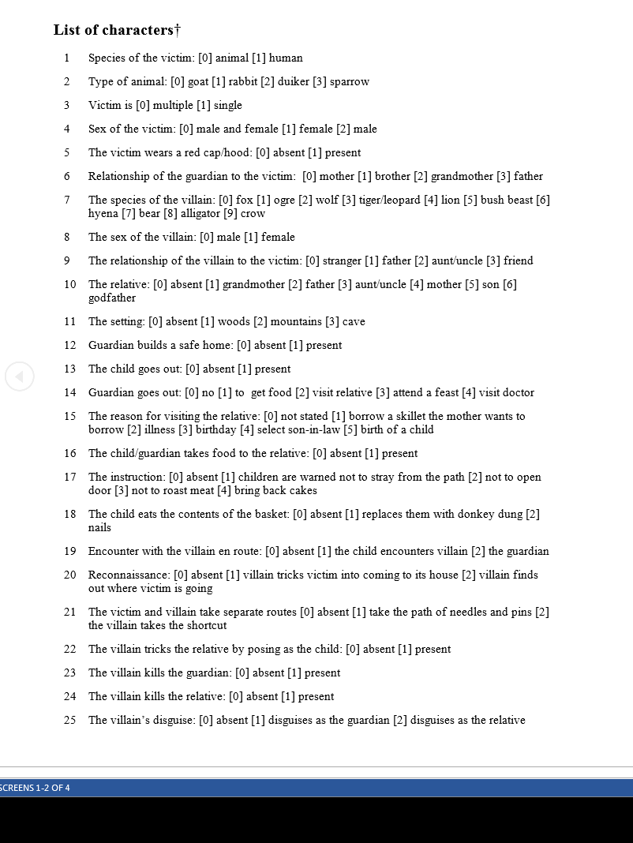

Slide 41
Reason 7: Be a (research) star!
20 Neighbour-joining
41 Bootstrap for Phylogenetics
45 MEGA
76 Modeltest
100 MrBayes
http://www.nature.com/news/the-top-100-papers-1.16224

Slide 42
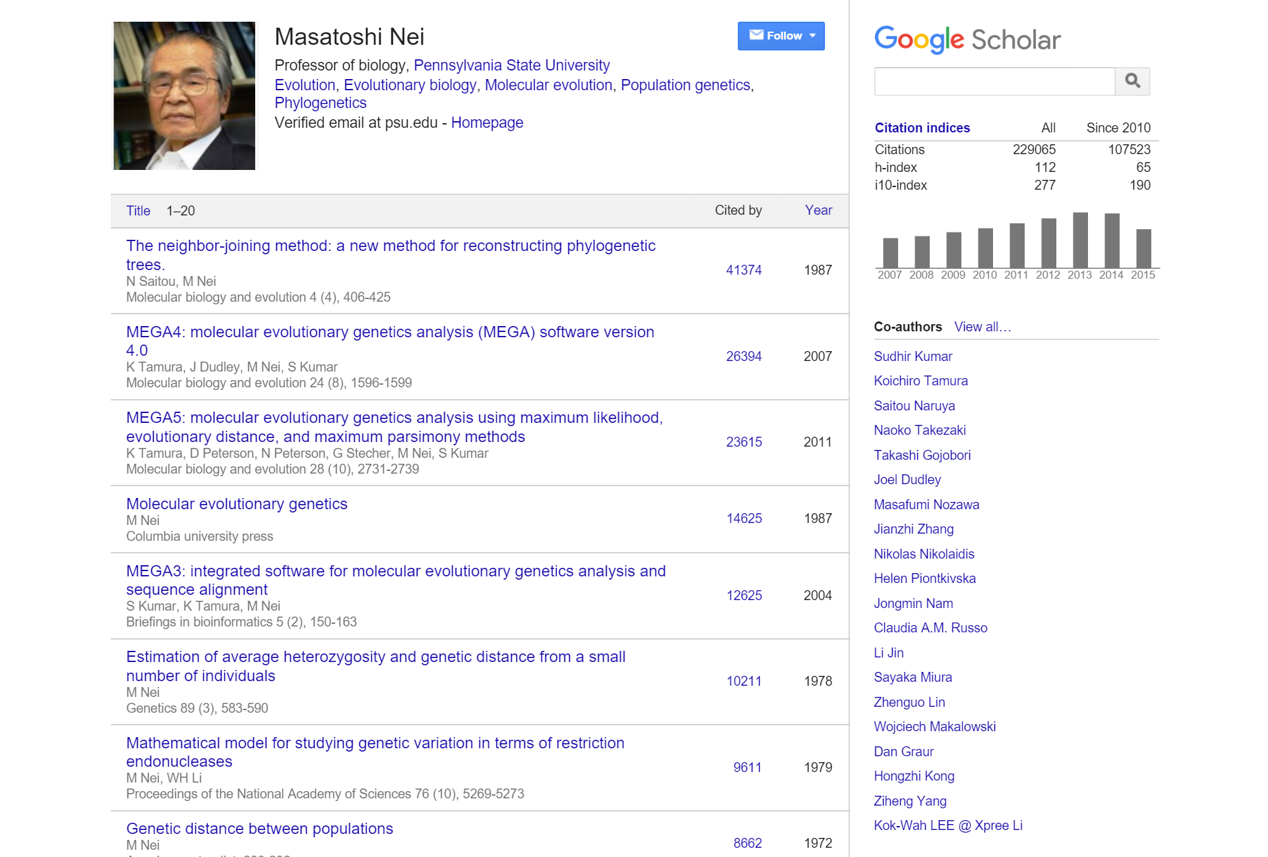

Slide 43
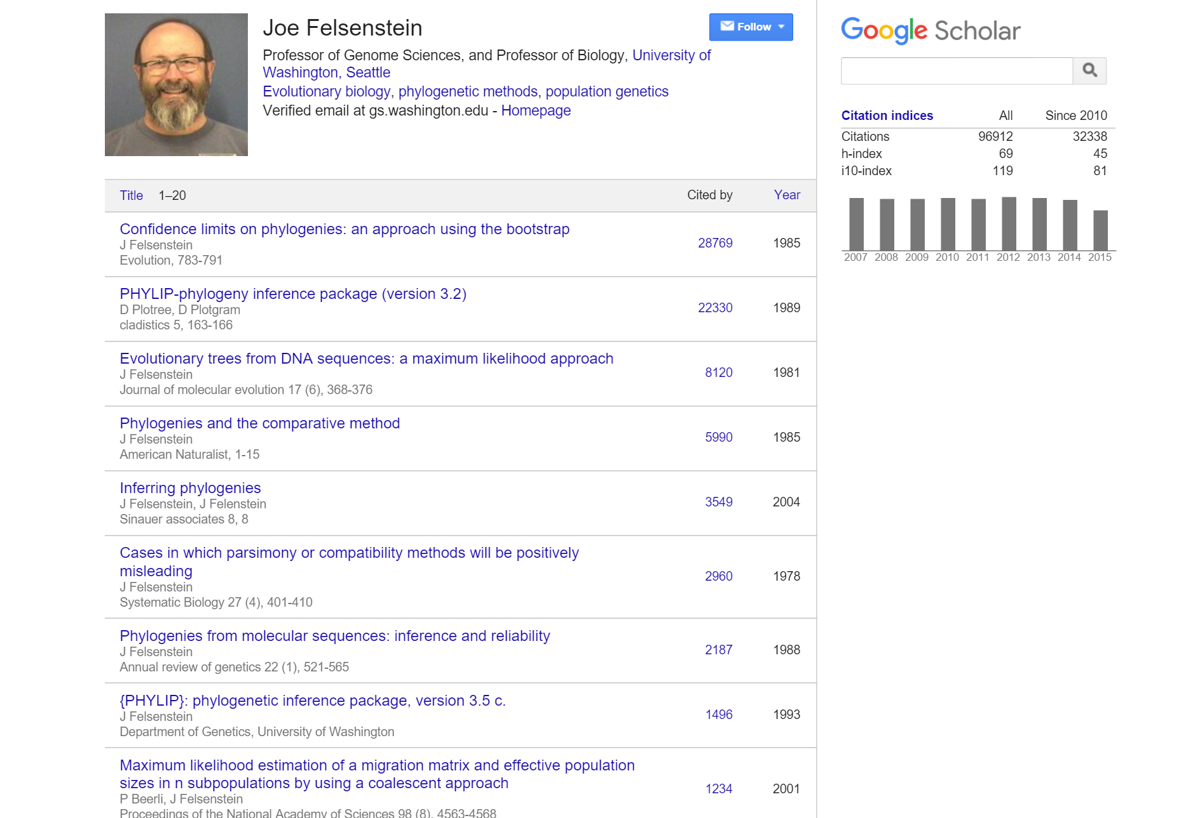
Efron 1979
12455

