Slide 1
ONE thing I wish I knew

Slide 2
How can we allow for extinction and non-neutral evolution in using phylogenies?**
* ancestral state reconstruction, deriving evolutionary parameters from trees
** answering this might help in constructing phylogenies

Slide 3
Extinction effects...

Slide 4
underlying models
choices...
some allow for extinction
most only permit homogenous processes
some allow for directional evolution
do they do the job properly?

Slide 5
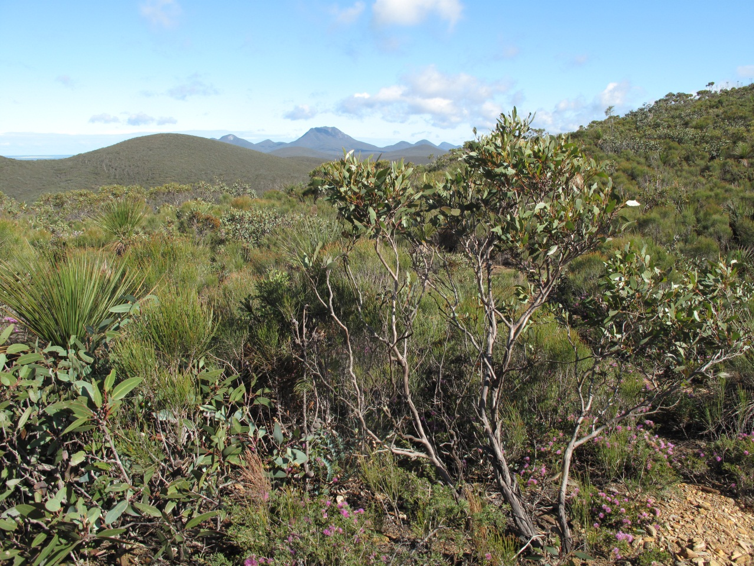
1. a global evolutionary question

Slide 6
Proteaceae...

Slide 7
Proteaceae
- 1500 sclerophyll species (open vegetation)
only 250 rainforest species (closed vegetation), but in more clades
Hypothesis: open vegetation species evolve faster in response to climate

Slide 8
testing this
BAMM* rates of evolution for tips (absolute values)
Rate of change
in morphology
Rate of change in climate (“niche”)
* a model that reconstructs evolutionary parameters allowing for variable rates etc...

Slide 10
it’s an artefact of the model

Slide 11
it’s an artefact of the model
But it’s worse
even though the absolute values of rates of changes in morphology and climate are correlated, the directions are random

Slide 12
something wrong with the model
assumption set?

Slide 13
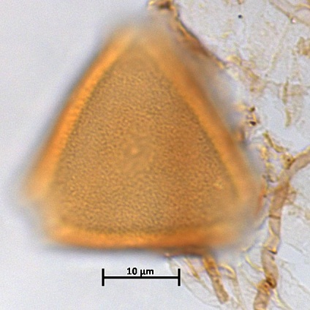
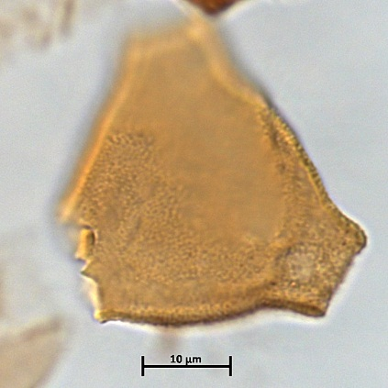
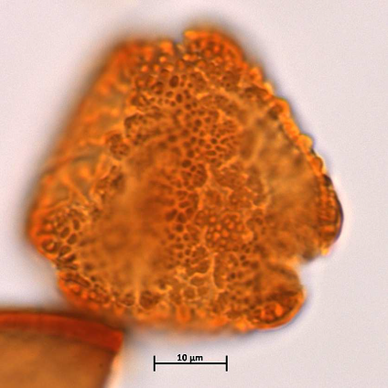
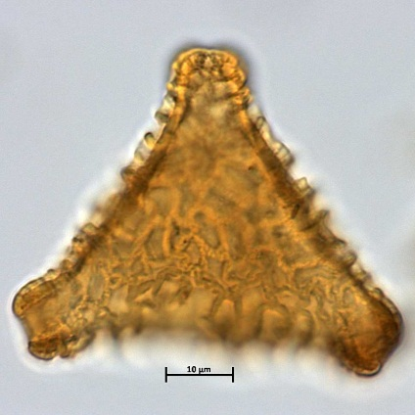
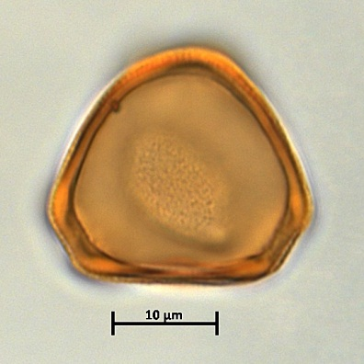
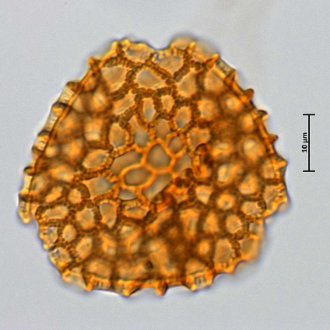
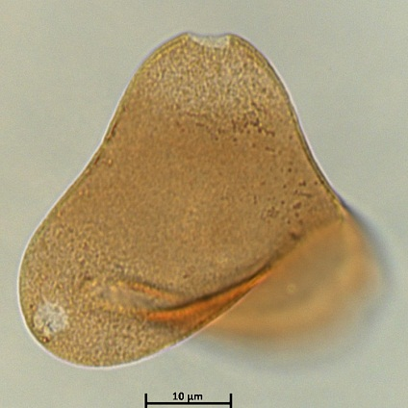
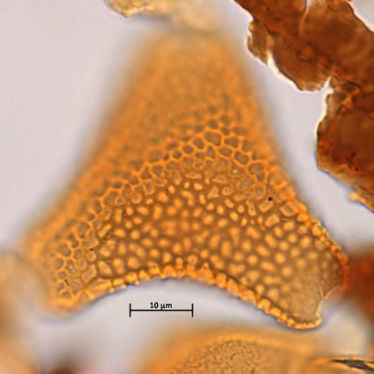
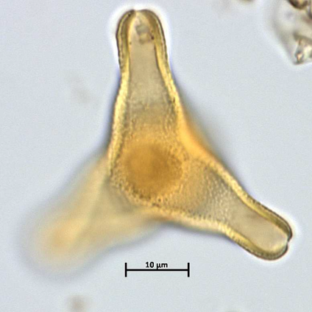
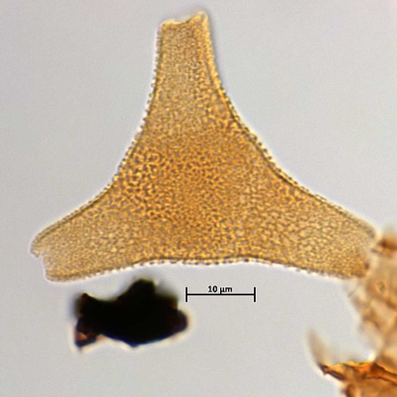
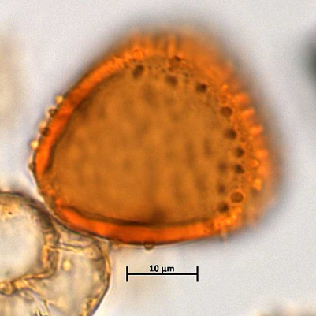
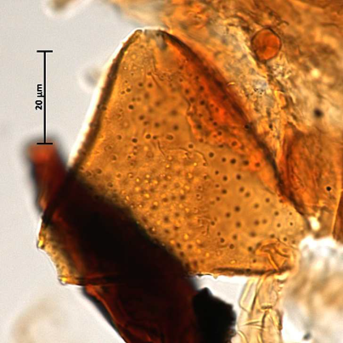
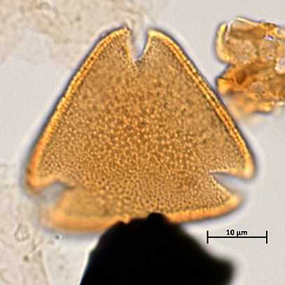
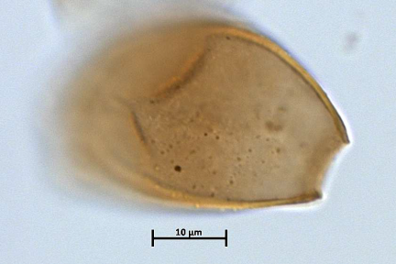
Extinction and direction...

Slide 14
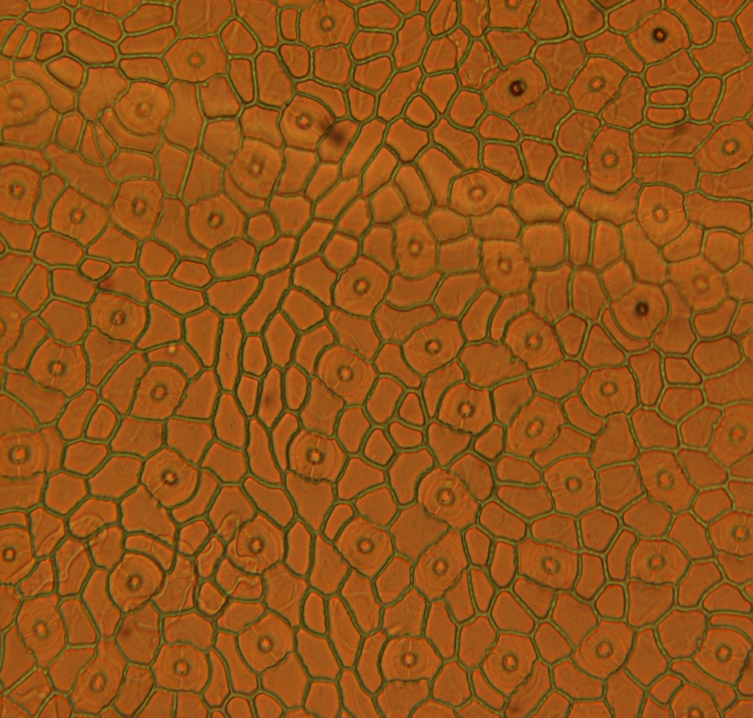
Stomata – size is important

Slide 16
But this is all invisible in the phylogeny

Slide 18
Why?
1 Overparameterisation or poor parameterisation?

Slide 19
Ancestral state reconstruction accuracy (simulation)

Slide 20
Why
2 Regression to the mean and failures to estimate outside the training set?

Slide 21
The ancestral state reconstruction shows no trend in spite of directional selection

Slide 22
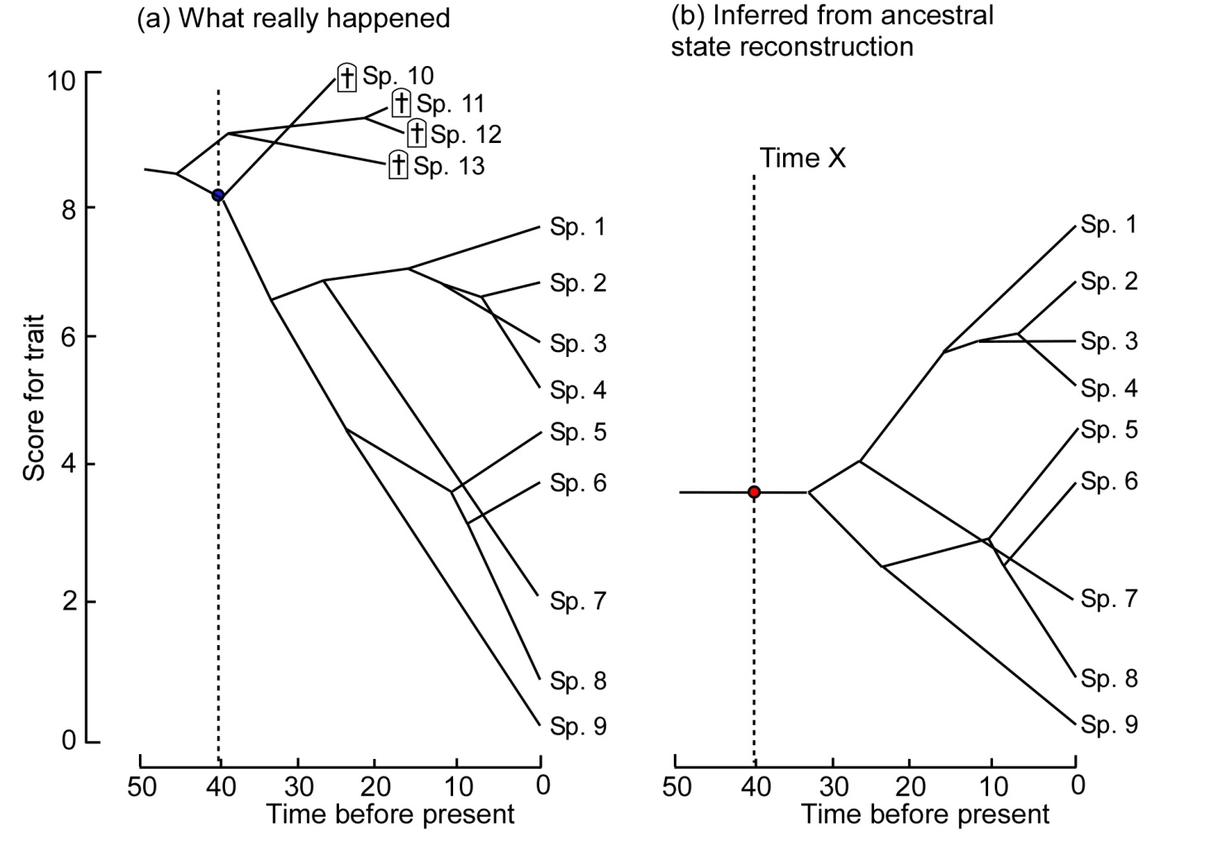
A cheap simulation

Slide 26
Problems apply to reconstructing phylogenies as well

Slide 27
Incorporate extra information?
Signals of past selection
fossil traits
current geographic and environmental ranges
Signals from functional traits
Comparative study of different gene trees
especially specific functional genes (climate etc, known drivers or indicators of directional evolution etc) versus non-coding genes

Slide 28
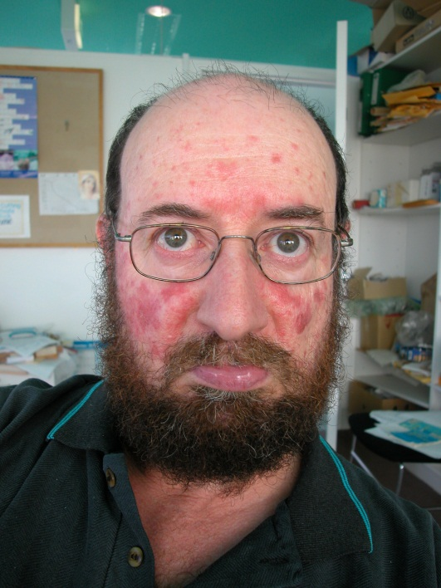
culprit
innocent bystanders
Barbara Holland
Saan Ketelaar-Jones
Ray Carpenter
Tim Brodribb
Bob Hill
ARC Discovery Grants
and others

